Slide 1

P peline
The Data
Data Storage
© Jennifer Mankoff
The Data Pipeline; HCII; Spring 2014

Slide 2
What is Data?

Slide 3
Types of Data
Unstructured – e.g. text
Semi-Structured – e.g. XML (RSS feeds are a specific example of this)
Structured – e.g. a MySQL database

Slide 4
Structured, Semi Structured and Unstructured Data
Three characterizations:
Structured Data
Semi-Structured Data
Unstructured Data
Structured Data:
Information stored in databases is known as structured data because it is represented in a strict format.
The DBMS then checks to ensure that all data follows the structures and constraints specified in the schema.

Slide 5
Unstructured Data
Twitter posts (actually: semi-structured. Why?)
HTML (is it?)

Slide 6
Structured, Semi Structured and Unstructured Data (contd.)
Unstructured Data:
A third category is known as unstructured data, because there is very limited indication of the type of data.
A typical example would be a text document that contains information embedded within it. Web pages in HTML that contain some data are considered as unstructured data.

Slide 7
Structured, Semi Structured and Unstructured Data (contd.)
Semi-Structured Data:
In some applications, data is collected in an ad-hoc manner before it is known how it will be stored and managed.
This data may have a certain structure, but not all the information collected will have identical structure. This type of data is known as semi-structured data.
In semi-structured data, the schema information is mixed in with the data values, since each data object can have different attributes that are not known in advance. Hence, this type of data is sometimes referred to as self-describing data.

Slide 8
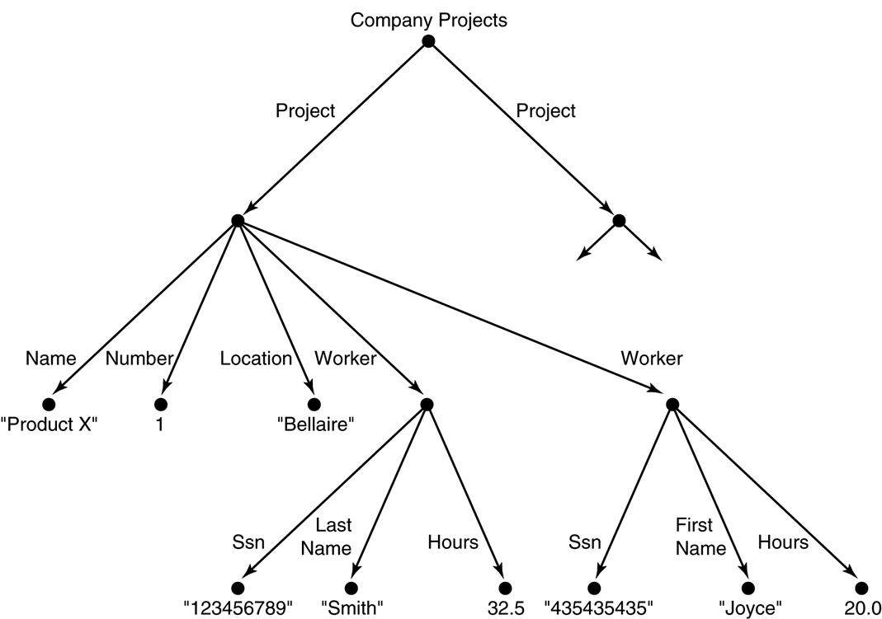
Structured, Semi Structured and Unstructured Data (contd.)
Semi-structured data may be displayed as a directed graph...
The labels or tags on the directed edges represent the schema names—the names of attributes, object types (or entity types or classes), and relationships.
The internal nodes represent individual objects or composite attributes.
The leaf nodes represent actual data values of simple (atomic) attributes.

Slide 9
Semi-structured Data
XML is the prototypical example
XML can be used to provide more information about the structure and meaning of the data in the Web pages rather than just specifying how the Web pages are formatted for display on the screen.

Slide 10
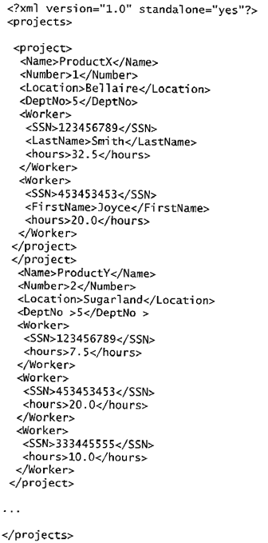
XML Hierarchical (Tree) Data Model
FIGURE 27.3 A complex XML element called <projects>

Slide 11
XML Hierarchical (Tree) Data Model (contd.)
The basic object is XML is the XML document.
There are two main structuring concepts that are used to construct an XML document:
Elements
Attributes
Attributes in XML provide additional information that describe elements.

Slide 12
XML Hierarchical (Tree) Data Model (contd.)
As in HTML, elements are identified in a document by their start tag and end tag.
The tag names are enclosed between angled brackets <…>, and end tags are further identified by a backslash </…>.
Complex elements are constructed from other elements hierarchically, whereas simple elements contain data values.
It is straightforward to see the correspondence between the XML textual representation and the tree structure.
In the tree representation, internal nodes represent complex elements, whereas leaf nodes represent simple elements.
That is why the XML model is called a tree model or a hierarchical model.

Slide 13
XML Documents, DTD, and XML Schema
Two types of XML
Well-Formed XML
Valid XML

Slide 14
XML Documents, DTD, and XML Schema
Well-Formed XML
It must start with an XML declaration to indicate the version of XML being used—as well as any other relevant attributes.
It must follow the syntactic guidelines of the tree model.
This means that there should be a single root element, and every element must include a matching pair of start tag and end tag within the start and end tags of the parent element.

Slide 15
XML Documents, DTD, and XML Schema
Well-Formed XML (contd.)
A well-formed XML document is syntactically correct
This allows it to be processed by generic processors that traverse the document and create an internal tree representation.
DOM (Document Object Model) - Allows programs to manipulate the resulting tree representation corresponding to a well-formed XML document. The whole document must be parsed beforehand when using dom.
SAX - Allows processing of XML documents on the fly by notifying the processing program whenever a start or end tag is encountered.

Slide 16
XML Documents, DTD, and XML Schema
Valid XML
A stronger criterion is for an XML document to be valid.
In this case, the document must be well-formed, and in addition the element names used in the start and end tag pairs must follow the structure specified in a separate XML DTD (Document Type Definition) file or XML schema file.

Slide 17
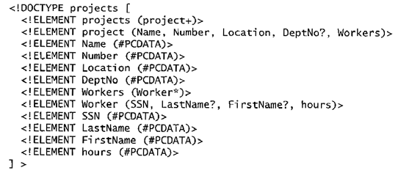
XML Documents, DTD, and XML Schema (contd.)
FIGURE 27.4 An XML DTD file called projects

Slide 18
XML Documents, DTD, and XML Schema (contd.)
XML DTD Notation
A * following the element name means that the element can be repeated zero or more times in the document. This can be called an optional multivalued (repeating) element.
A + following the element name means that the element can be repeated one or more times in the document. This can be called a required multivalued (repeating) element.
A ? following the element name means that the element can be repeated zero or one times. This can be called an optional single-valued (non-repeating) element.
An element appearing without any of the preceding three symbols must appear exactly once in the document. This can be called an required single-valued (non-repeating) element.

Slide 19
XML Documents, DTD, and XML Schema (contd.)
XML DTD Notation (contd.)
The type of the element is specified via parentheses following the element.
If the parentheses include names of other elements, these would be the children of the element in the tree structure.
If the parentheses include the keyword #PCDATA or one of the other data types available in XML DTD, the element is a leaf node. PCDATA stands for parsed character data, which is roughly similar to a string data type.
Parentheses can be nested when specifying elements.
A bar symbol ( e1 | e2 ) specifies that either e1 or e2 can appear in the document.

Slide 20
XML Documents, DTD, and XML Schema (contd.)
Limitations of XML DTD
First, the data types in DTD are not very general.
Second, DTD has its own special syntax and so it requires specialized processors.
It would be advantageous to specify XML schema documents using the syntax rules of XML itself so that the same processors for XML documents can process XML schema descriptions.
Third, all DTD elements are always forced to follow the specified ordering the document so unordered elements are not permitted.

Slide 21
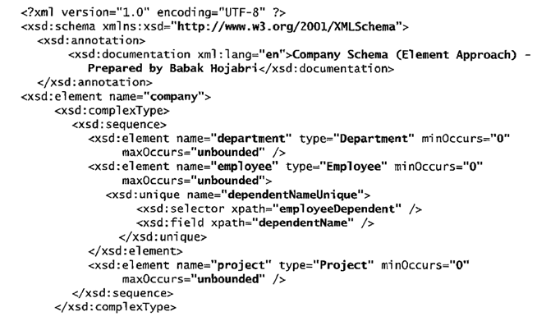
XML Documents, DTD, and XML Schema (contd.)
FIGURE 27.5 An XML schema file called company

Slide 22
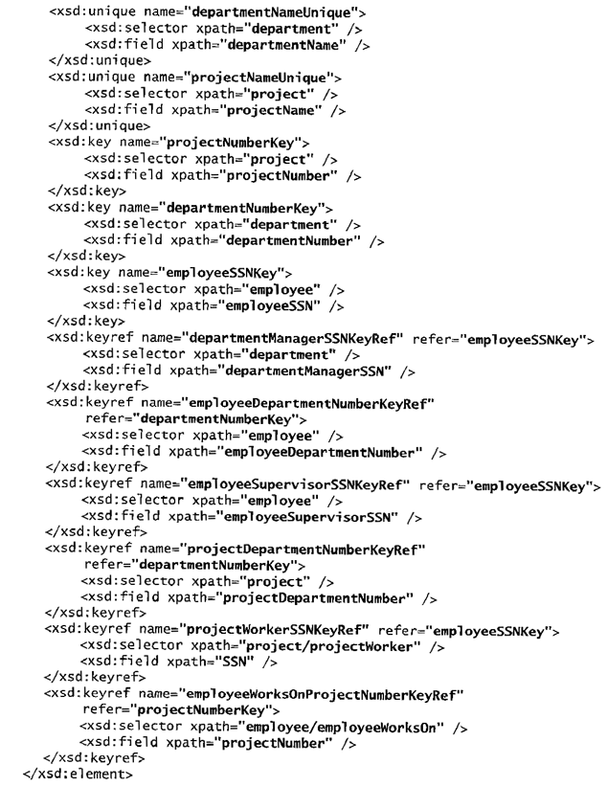
XML Documents, DTD, and XML Schema (contd.)
FIGURE 27.5 An XML schema file called company (contd.)

Slide 23
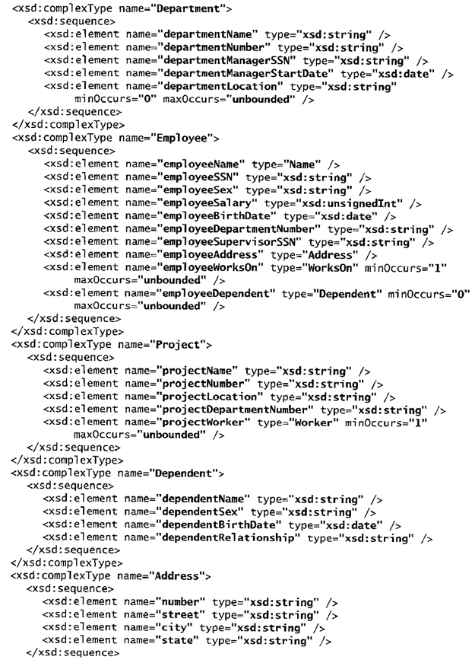
XML Documents, DTD, and XML Schema (contd.)
FIGURE 27.5 An XML schema file called company (contd.)

Slide 24
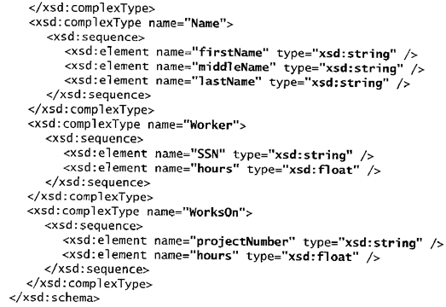
XML Documents, DTD, and XML Schema (contd.)
FIGURE 27.5 An XML schema file called company (contd.)

Slide 25
XML Documents, DTD, and XML Schema (contd.)
XML Schema
Schema Descriptions and XML Namespaces
It is necessary to identify the specific set of XML schema language elements (tags) by a file stored at a Web site location.
The second line in our example specifies the file used in this example, which is: "http://www.w3.org/2001/XMLSchema".
Each such definition is called an XML namespace.
The file name is assigned to the variable xsd using the attribute xmlns (XML namespace), and this variable is used as a prefix to all XML schema tags.

Slide 26
XML Documents, DTD, and XML Schema (contd.)
XML Schema (contd.)
Annotations, documentation, and language used:
The xsd:annotation and xsd:documentation are used for providing comments and other descriptions in the XML document.
The attribute XML:lang of the xsd:documentation element specifies the language being used. E.g., “en”

Slide 27
XML Documents, DTD, and XML Schema (contd.)
XML Schema (contd.)
Elements and types:
We specify the root element of our XML schema. In XML schema, the name attribute of the xsd:element tag specifies the element name, which is called company for the root element in our example.
The structure of the company root element is a xsd:complexType.

Slide 28
XML Documents, DTD, and XML Schema (contd.)
XML Schema (contd.)
First-level elements in the company database:
These elements are named employee, department, and project, and each is specified in an xsd:element tag. If a tag has only attributes and no further sub-elements or data within it, it can be ended with the back slash symbol (/>) and termed Empty Element.

Slide 29
XML Documents, DTD, and XML Schema (contd.)
XML Schema (contd.)
Specifying element type and minimum and maximum occurrences:
If we specify a type attribute in an xsd:element, this means that the structure of the element will be described separately, typically using the xsd:complexType element. The minOccurs and maxOccurs tags are used for specifying lower and upper bounds on the number of occurrences of an element. The default is exactly one occurrence.

Slide 30
XML Documents, DTD, and XML Schema (contd.)
XML Schema (contd.)
Specifying Keys:
For specifying primary keys, the tag xsd:key is used.
For specifying foreign keys, the tag xsd:keyref is used.
When specifying a foreign key, the attribute refer of the xsd:keyref tag specifies the referenced primary key whereas the tags xsd:selector and xsd:field specify the referencing element type and foreign key.

Slide 31
XML Documents, DTD, and XML Schema (contd.)
XML Schema (contd.)
Specifying the structures of complex elements via complex types:
Complex elements in our example are Department, Employee, Project, and Dependent, which use the tag xsd:complexType. We specify each of these as a sequence of subelements corresponding to the database attributes of each entity type by using the xsd:sequence and xsd:element tags of XML schema. Each element is given a name and type via the attributes name and type of xsd:element.
We can also specify minOccurs and maxOccurs attributes if we need to change the default of exactly one occurrence. For (optional) database attributes where null is allowed, we need to specify minOccurs = 0, whereas for multivalued database attributes we need to specify maxOccurs = “unbounded” on the corresponding element.

Slide 32
XML Documents, DTD, and XML Schema (contd.)
XML Schema (contd.)
Composite (compound) attributes:
Composite attributes from ER Schema are also specified as complex types in the XML schema, as illustrated by the Address, Name, Worker, and WorksOn complex types. These could have been directly embedded within their parent elements.

Slide 33
XML Documents and Databases.
Approaches to Storing XML Documents
Using a DBMS to store the documents as text:
We can use a relational or object DBMS to store whole XML documents as text fields within the DBMS records or objects. This approach can be used if the DBMS has a special module for document processing, and would work for storing schemaless and document-centric XML documents.
Using a DBMS to store the document contents as data elements:
This approach would work for storing a collection of documents that follow a specific XML DTD or XML schema. Since all the documents have the same structure, we can design a relational (or object) database to store the leaf-level data elements within the XML documents.

Slide 34
XML Documents and Databases.
Approaches to Storing XML Documents (contd.)
Designing a specialized system for storing native XML data:
A new type of database system based on the hierarchical (tree) model would be designed and implemented. The system would include specialized indexing and querying techniques, and would work for all types of XML documents.
Creating or publishing customized XML documents from pre-existing relational databases:
Because there are enormous amounts of data already stored in relational databases, parts of these data may need to be formatted as documents for exchanging or displaying over the Web.

Slide 35
XML Documents, DTD, and XML Schema (contd.)
Extracting XML Documents from Relational Databases.
Suppose that an application needs to extract XML documents for student, course, and grade information from the university database.
The data needed for these documents is contained in the database attributes of the entity types course, section, and student as shown below (part of the main ER), and the relationships s-s and c-s between them.

Slide 36
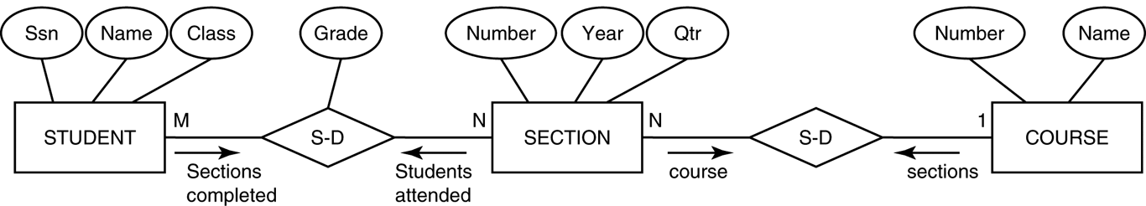
Subset of the UNIVERSITY database schema
FIGURE 27.7 Subset of the UNIVERSITY database schema needed for XML document extraction.

Slide 37
XML Documents, DTD, and XML Schema (contd.)
Extracting XML Documents from Relational Databases
One of the possible hierarchies that can be extracted from the database subset could choose COURSE as the root.

Slide 38
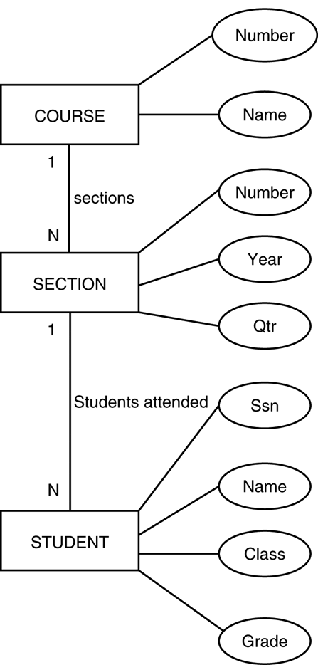
Hierarchical (tree) view with COURSE as the root
FIGURE 27.8 Hierarchical (tree) view with COURSE as the root.

Slide 39
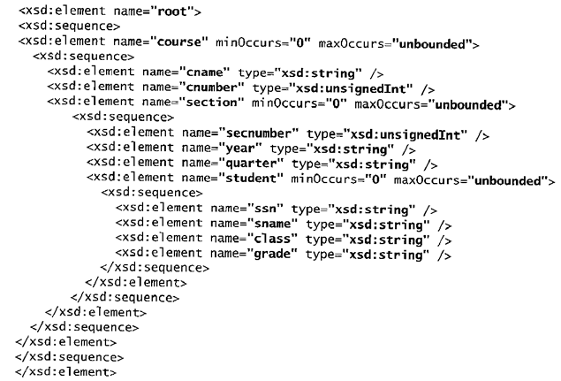
XML schema document with COURSE as the root
FIGURE 27.9

Slide 40
XML Documents, DTD, and XML Schema (contd.)
Breaking Cycles To Convert Graphs into Trees
It is possible to have a more complex subset with one or more cycles, indicating multiple relationships among the entities.
Suppose that we need the information in all the entity types and relationships in figure below for a particular XML document, with student as the root element.

Slide 41
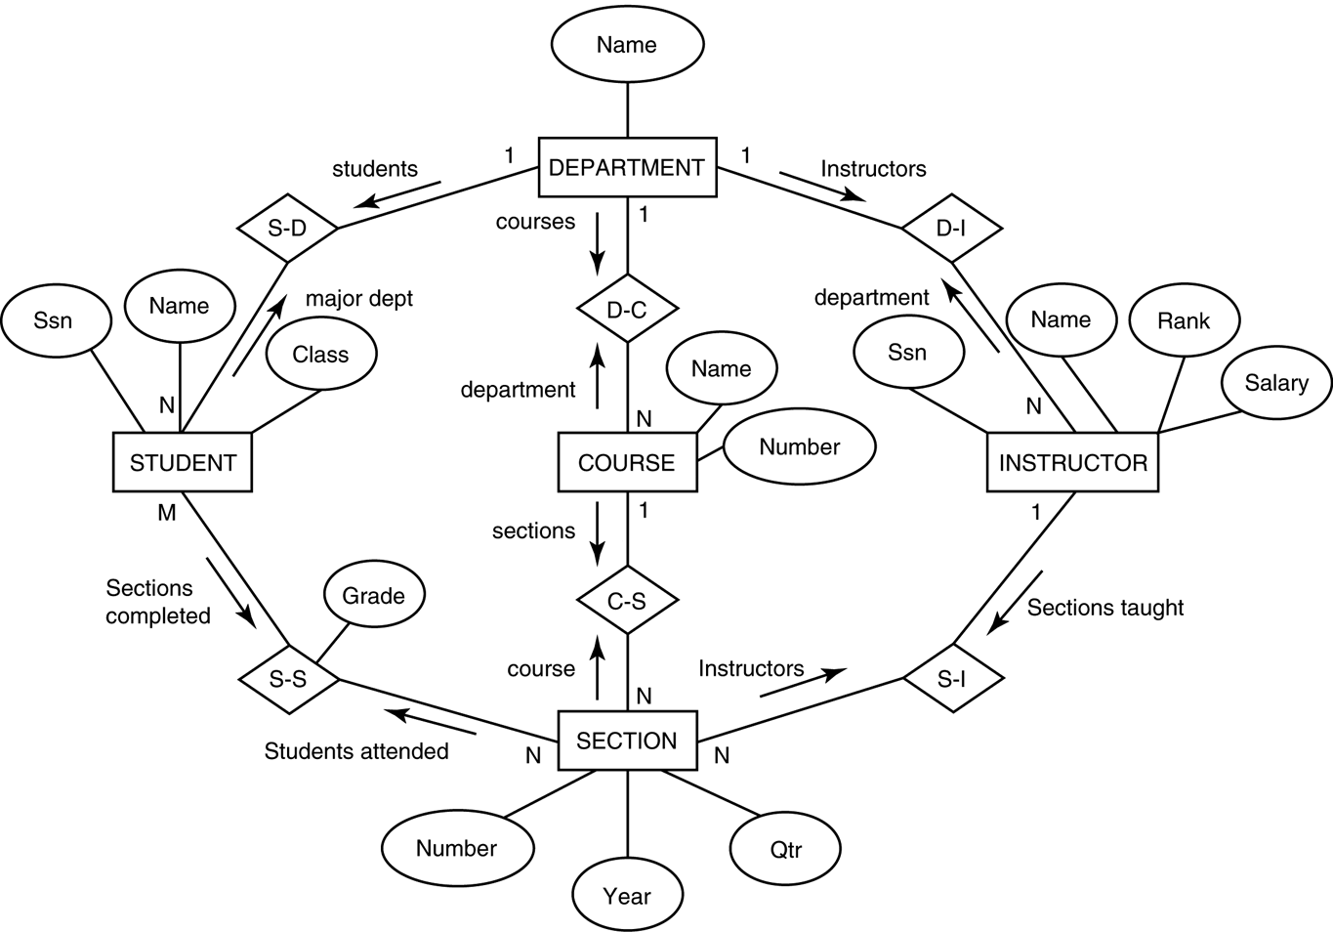
An ER schema diagram for a simplified UNIVERSITY database.
FIGURE 27.6

Slide 42
XML Documents, DTD, and XML Schema (contd.)
Breaking Cycles To convert Graphs into Trees
One way to break the cycles is to replicate the entity types involved in cycles.
First, we replicate INSTRUCTOR as shown in part (2) of Figure, calling the replica to the right INSTRUCTOR1. The INSTRUCTOR replica on the left represents the relationship between instructors and the sections they teach, whereas the INSTRUCTOR1 replica on the right represents the relationship between instructors and the department each works in.
We still have the cycle involving COURSE, so we can replicate COURSE in a similar manner, leading to the hierarchy shown in part (3) . The COURSE1 replica to the left represents the relationship between courses and their sections, whereas the COURSE replica to the right represents the relationship between courses and the department that offers each course.

Slide 43
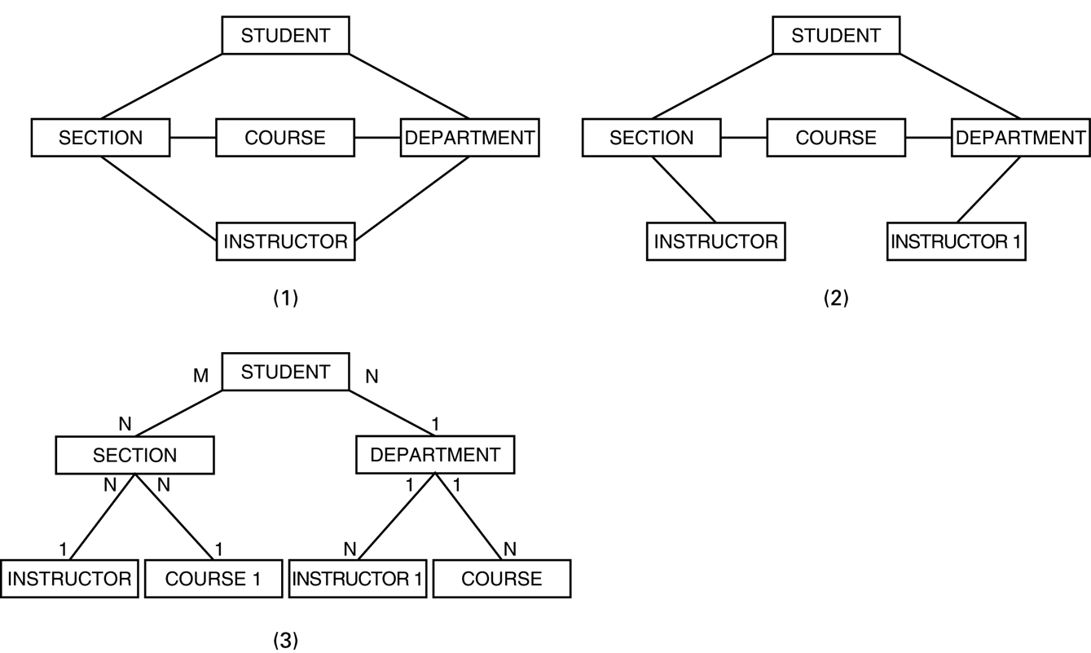
Converting a graph with cycles into a hierarchical (tree) structure
FIGURE 27.13

Slide 44
XML Querying
XPath
An XPath expression returns a collection of element nodes that satisfy certain patterns specified in the expression.
The names in the XPath expression are node names in the XML document tree that are either tag (element) names or attribute names, possibly with additional qualifier conditions to further restrict the nodes that satisfy the pattern.

Slide 45
XML Querying
XPath (contd.)
There are two main separators when specifying a path:
single slash (/) and double slash (//)
A single slash before a tag specifies that the tag must appear as a direct child of the previous (parent) tag, whereas a double slash specifies that the tag can appear as a descendant of the previous tag at any level.
It is customary to include the file name in any XPath query allowing us to specify any local file name or path name that specifies the path.
doc(www.company.com/info.XML)/company => COMPANY XML doc

Slide 46
XML Querying
Returns the COMPANY root node and all its descendant nodes, which means that it returns the whole XML document.
Returns all department nodes (elements) and their descendant subtrees.
Returns all employeeName nodes that are direct children of an employee node, such that the employee node has another child element employeeSalary whose value is greater than 70000.
This returns the same result as the previous one except that we specified the full path name in this example.
This returns all projectWorker nodes and their descendant nodes that are children under a path /company/project and that have a child node hours with value greater than 20.0 hours.

Slide 47
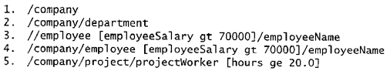
Some examples of XPath expressions
FIGURE 27.14 Some examples of XPath expressions on XML documents that follow the XML schema file COMPANY in FIGURE 27.5.

Slide 48
XML Querying
XQuery
XQuery uses XPath expressions, but has additional constructs.
XQuery permits the specification of more general queries on one or more XML documents.
The typical form of a query in XQuery is known as a FLWR expression, which stands for the four main clauses of XQuery and has the following form:
FOR <variable bindings to individual nodes (elements)>
LET <variable bindings to collections of nodes (elements)>
WHERE <qualifier conditions>
RETURN <query result specification>

Slide 49
XML Querying
This query retrieves the first and last names of employees who earn more than 70000. The variable $x is bound to each employeeName element that is a child of an employee element, but only for employee elements that satisfy the qualifier that their employeeSalary is greater that 70000.
This is an alternative way of retrieving the same elements retrieved by the first query.
This query illustrates how a join operation can be performed by having more than one variable. Here, the $x variable is bound to each projectWorker element that is a child of project number 5, whereas the $y variable is bound to each employee element. The join condition matches SSN values in order to retrieve the employee names.

Slide 50
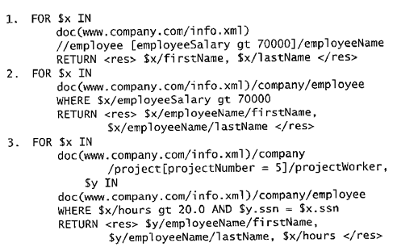
Some Examples of XQuery Queries
Some examples of XQuery queries on XML documents that follow the XML schema file COMPANY in FIGURE 27.5.

Slide 51
Recap
Introduction
Structured, Semi structured, and Unstructured Data.
XML Hierarchical (Tree) Data Model.
XML Documents, DTD, and XML Schema.
XML Documents and Databases.
XML Querying.
XPath
XQuery

Slide 52
Structured Data
How is it structured; if at all?
What are the fields and Values?
Does it have multiple tables or just one?
Is it designed for machine consumption or human consumption?
Is it in multiple files or one file?
Recommended Reading: The Bad Data Handbook (McCallum): O’Reilly Press

Slide 53
What is a Data Base?
Stores Information
Other jobs?
Notes:
Borrowed: Collections of information
Created with logical structures
With logical ties within the information
With built-in integrity constraints

Slide 54
THE RELATIONAL DATABASE MODEL
There are many types of databases
The relational database model is the most popular
Relational database – uses a series of logically related two-dimensional tables or files to store information in the form of a database

Slide 55
Databases – Collections of Information
Databases have many tables
Consider Solomon Enterprises that provides concrete to home and commercial builders. Tables or files include:
Order
Customer
Concrete Type
Employee
Truck

Slide 56
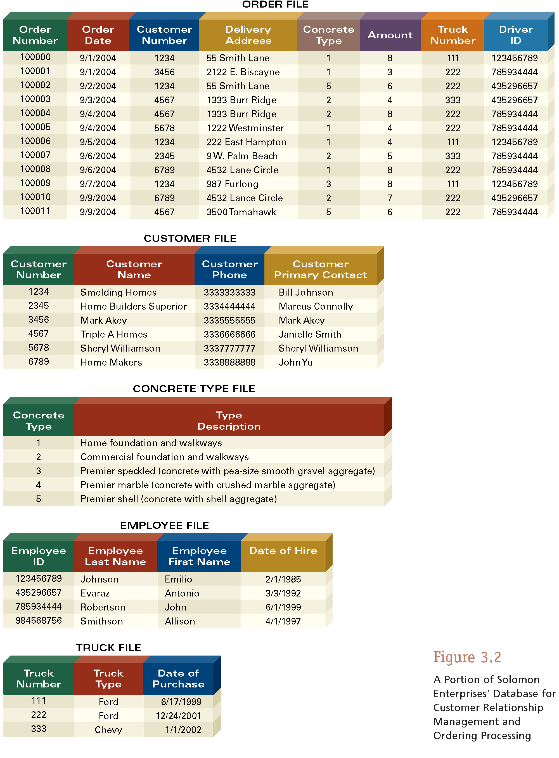
Databases – Collections of Information

Slide 57
Databases – Created with Logical Structures
In databases, the row number is irrelevant
Not true in spreadsheet software
In databases, column names are very important. Column names are created in the data dictionary
Data dictionary – contains the logical structure of the information in a database

Slide 58
Databases – With Logical Ties Within the Information
Logical ties must exist between the tables or files in a database
Logical ties are created with primary and foreign keys
Primary key – field (or group of fields in some cases) that uniquely describes each record
Can you find primary keys in Figure 3.1 on page 129?

Slide 59
Databases – With Logical Ties Within the Information
Foreign key – primary key of one file that appears in another file
Foreign keys help you create logical ties within the information in a database

Slide 60
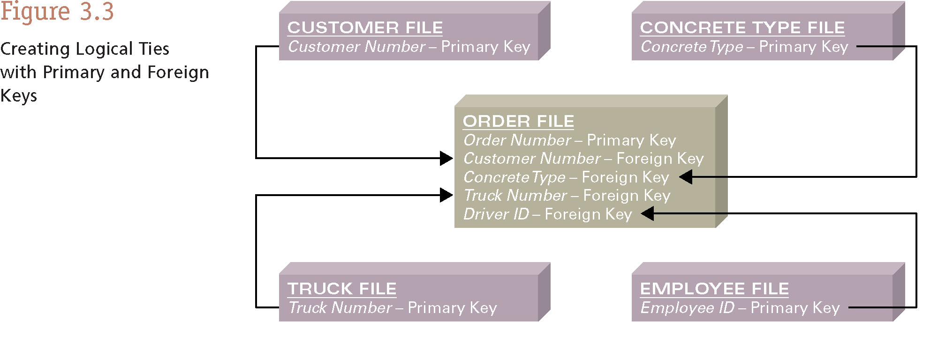
Databases – With Logical Ties Within the Information

Slide 61
Databases – With Built-In Integrity Constraints
Integrity constraints – rules that help ensure the quality of the information
Examples
Primary keys must be unique
Foreign keys must be present
Sales price cannot be negative
Phone number must have area code

Slide 62
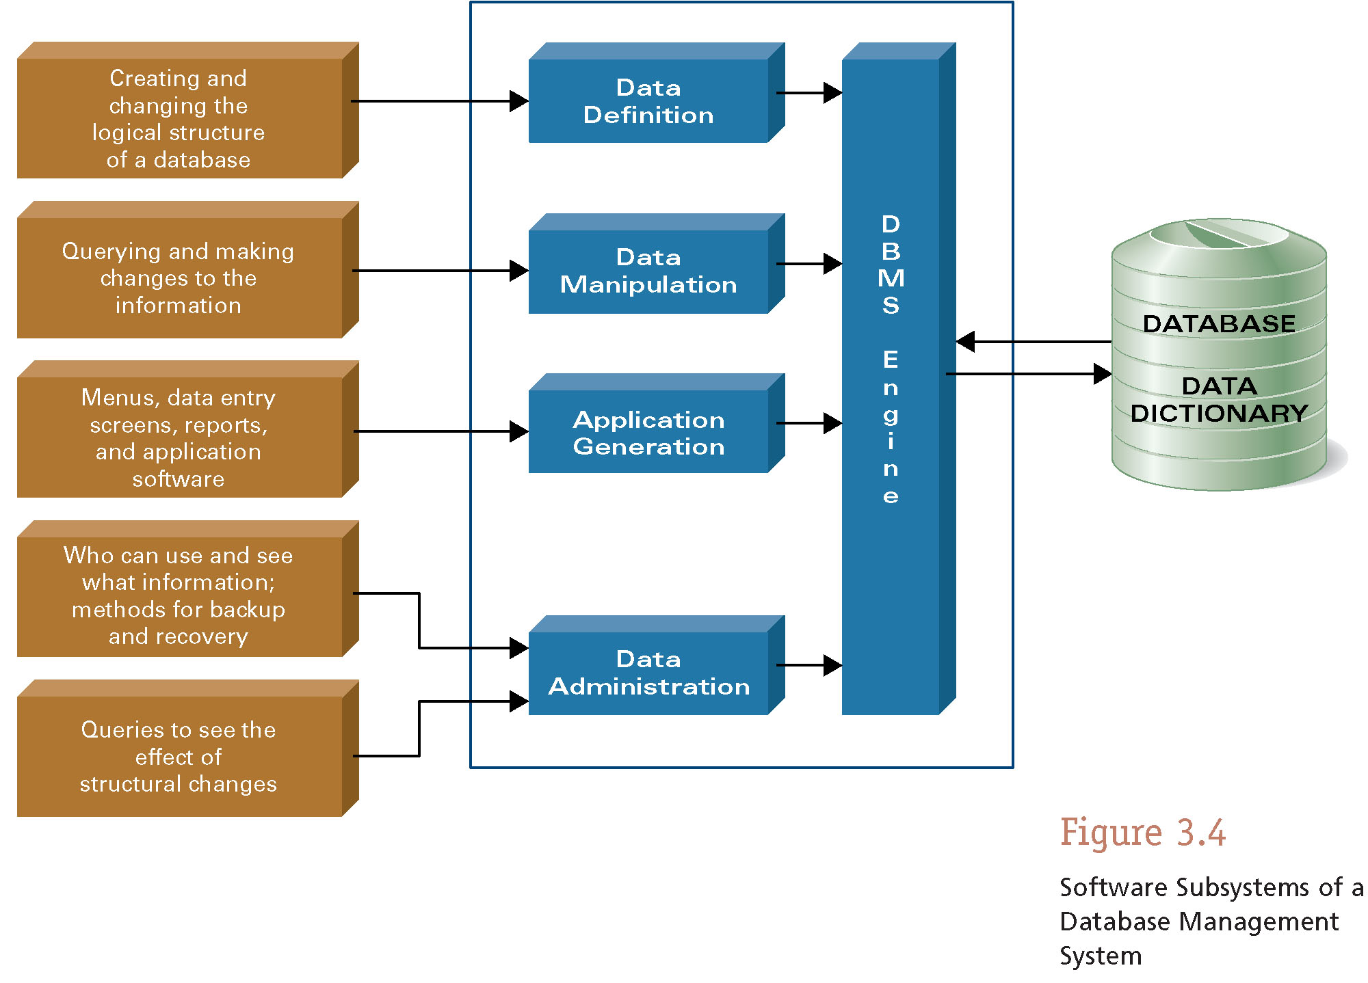
DATABASE MANAGEMENT SYSTEM TOOLS

Slide 63
DBMS Engine
DBMS engine – accepts logical requests from the various other DBMS subsystems, converts them into their physical equivalent, and actually accesses the database and data dictionary as they exist on a storage device
DBMS engine separates the logical from the physical

Slide 64
DBMS Engine
Physical view – how information is physically arranged, stored, and accessed on some type of storage device
Logical view – how you as a knowledge worker need to arrange and access information
With a database, you only concern yourself with your logical view

Slide 65
Data Definition Subsystem
Data definition subsystem – helps you create and maintain the data dictionary and define the structure of the files in a database
You must create a data dictionary before entering information into a database
Module J covers this for Microsoft Access

Slide 66
Data Manipulation Subsystem
Data manipulation subsystem – helps you add, change, and delete information
This is your primary DBMS interface as you work with a database
Views
Report generators
QBE tools
SQL

Slide 67
Views
View – allows you to see the contents of a database file
Make whatever changes you want
Perform simple sorting
Query to find the location of information
Looks similar to a workbook with no row numbers

Slide 68
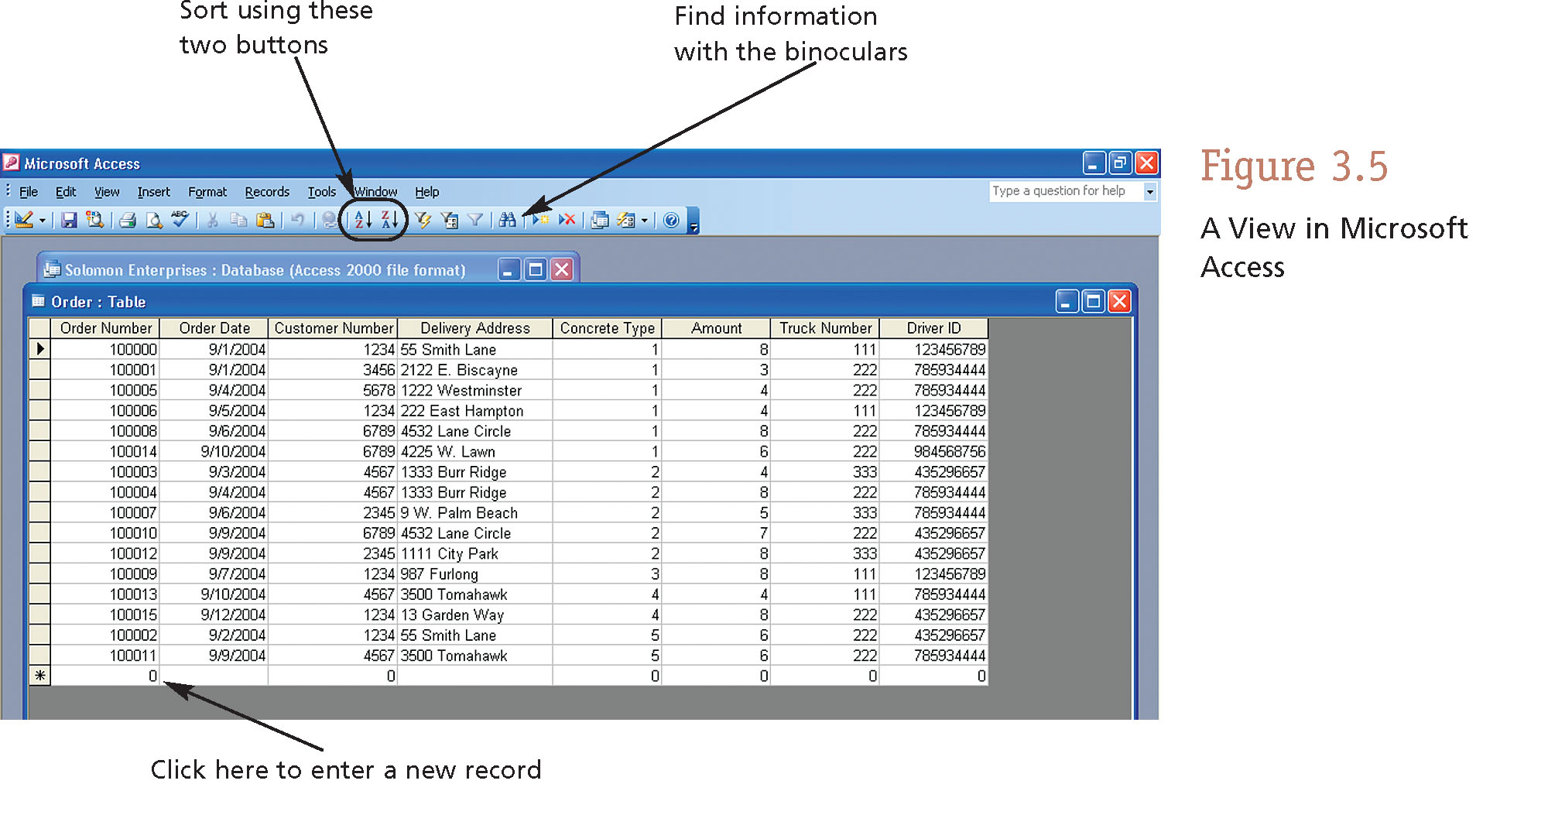
Views

Slide 69
Report Generators
Report generator – helps you quickly define formats of reports and what information you want to see in a report
You can save report formats and generate reports at any time with up-to-date information

Slide 70
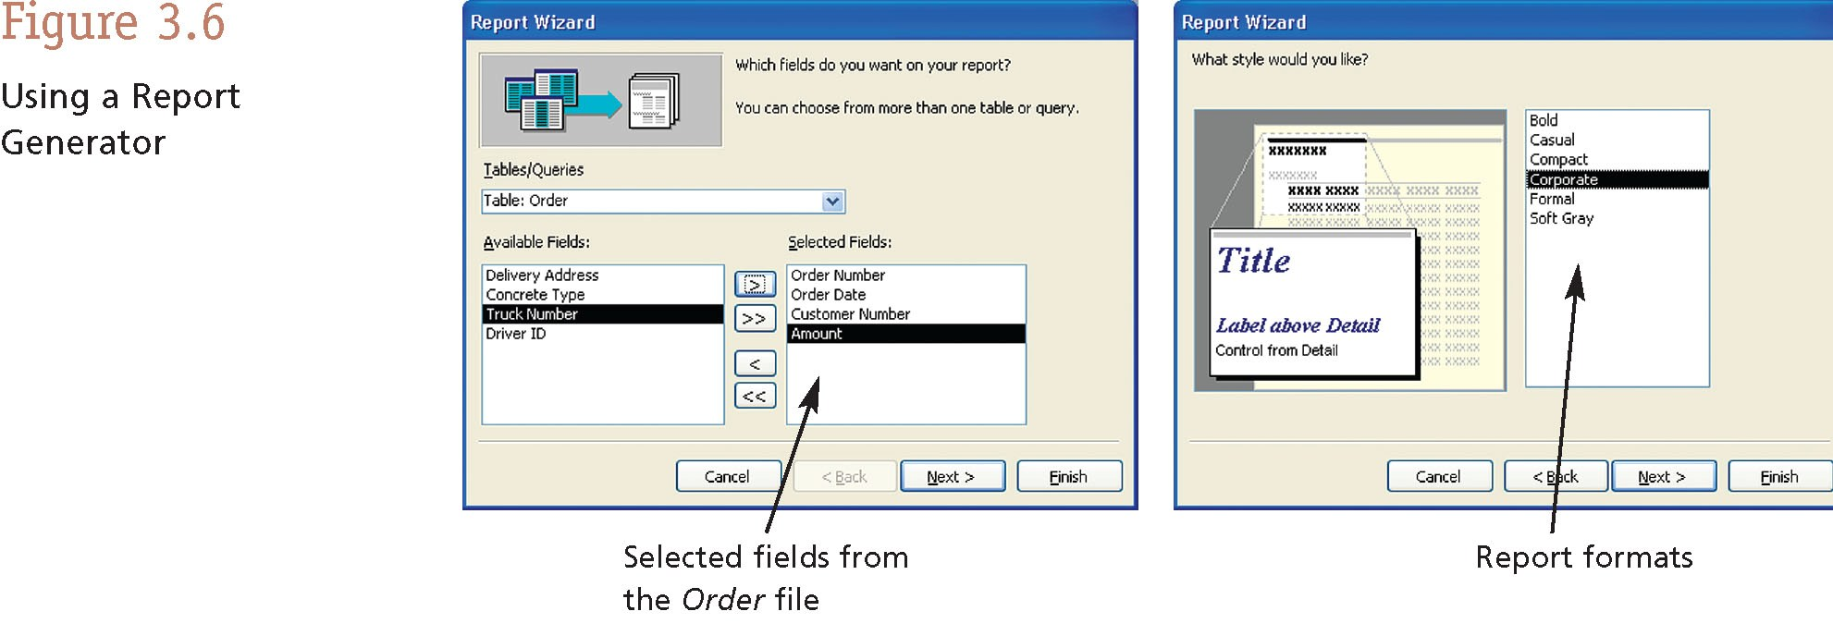
Report Generators

Slide 71
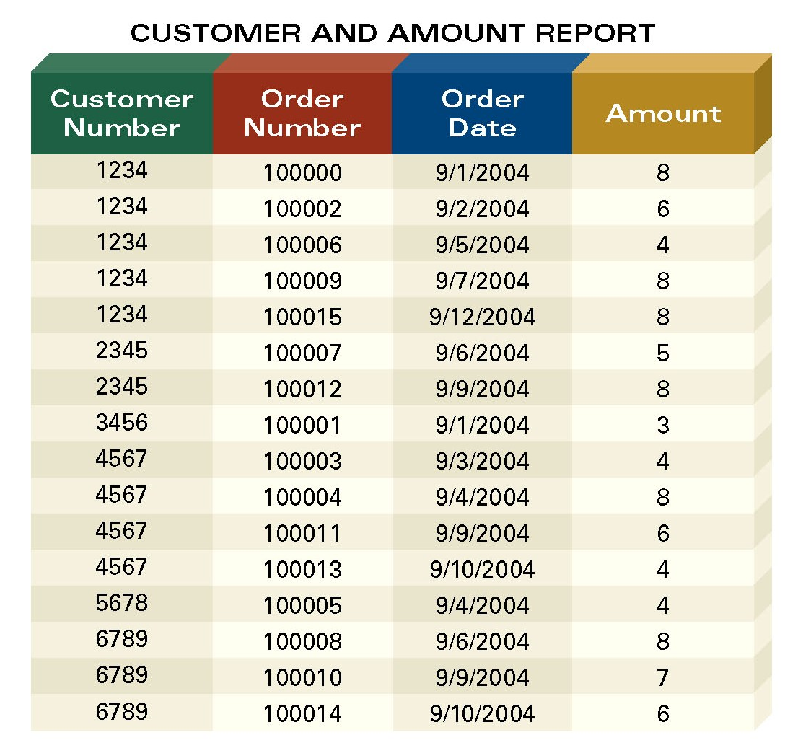
Report Generators

Slide 72
SQL
Structured query language (SQL) – standardized fourth-generation language found in most DBMSs
Performs the same task as a QBE tool
But uses a sentence structure instead of point-and-click interface
SQL is used mostly by IT people

Slide 73
MANAGING THE INFORMATION RESOURCE
Information is an organizational resource
Just like people, capital, and equipment
It must be managed effectively

Slide 74
MANAGING THE INFORMATION RESOURCE
Who should oversee your organization’s information resource?
Chief information officer (CIO) – oversees an organization’s information resource
Data administration – plans for, oversees the development of, and monitors the information resource
Database administration – technical and operational aspects of managing information

Slide 75
MANAGING THE INFORMATION RESOURCE
Is information ownership a consideration?
If you create information, you “own” it
You will also share it with others
Because you “own” it, you are responsible for its quality

Slide 76
MANAGING THE INFORMATION RESOURCE
How “clean” must your information be?
Duplicate information (records) must be eliminated
Inaccurate information must be corrected
Information forms the basis of business intelligence
If your business intelligence is bad, you will make poor decisions

Slide 77
Value of SDBMS
Traditional (non-spatial) database management systems provide:
Persistence across failures
Allows concurrent access to data
Scalability to search queries on very large datasets which do not fit inside main memories of computers
Efficient for non-spatial queries, but not for spatial queries
Non-spatial queries:
List the names of all bookstore with more than ten thousand titles.
List the names of ten customers, in terms of sales, in the year 2001
Spatial Queries:
List the names of all bookstores with ten miles of Minneapolis
List all customers who live in Tennessee and its adjoining states

Slide 78
Value of SDBMS – Spatial Data Examples
Examples of non-spatial data
Names, phone numbers, email addresses of people
Examples of Spatial data
Census Data
NASA satellites imagery - terabytes of data per day
Weather and Climate Data
Rivers, Farms, ecological impact
Medical Imaging
Exercise: Identify spatial and non-spatial data items in
A phone book
A cookbook with recipes

Slide 79
Value of SDBMS – Users, Application Domains
Many important application domains have spatial data and queries. Some Examples follow:
Army Field Commander: Has there been any significant enemy troop movement since last night?
Insurance Risk Manager: Which homes are most likely to be affected in the next great flood on the Mississippi?
Medical Doctor: Based on this patient's MRI, have we treated somebody with a similar condition ?
Molecular Biologist:Is the topology of the amino acid biosynthesis gene in the genome found in any other sequence feature map in the database ?
Astronomer:Find all blue galaxies within 2 arcmin of quasars.
Exercise: List two ways you have used spatial data. Which software did you use to manipulate spatial data?

Slide 80
Learning Objectives
Learning Objectives (LO)
LO1 : Understand the value of SDBMS
LO2: Understand the concept of spatial databases
What is a SDBMS?
How is it different from a GIS?
LO3: Learn about the Components of SDBMS
Sections for LO2
Section 1.5 provides an example SDBMS
Section 1.1 and 1.3 compare SDBMS with DBMS and GIS

Slide 81
What is a SDBMS ?
A SDBMS is a software module that
can work with an underlying DBMS
supports spatial data models, spatial abstract data types (ADTs) and a query language from which these ADTs are callable
supports spatial indexing, efficient algorithms for processing spatial operations, and domain specific rules for query optimization
Example: Oracle Spatial data cartridge, ESRI SDE
can work with Oracle 8i DBMS
Has spatial data types (e.g. polygon), operations (e.g. overlap) callable from SQL3 query language
Has spatial indices, e.g. R-trees

Slide 82
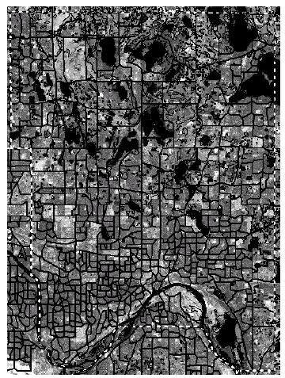
SDBMS Example
Consider a spatial dataset with:
County boundary (dashed white line)
Census block - name, area, population, boundary (dark line)
Water bodies (dark polygons)
Satellite Imagery (gray scale pixels)
Storage in a SDBMS table:
create table census_blocks (
name string,
area float,
population number,
boundary polygon );
Fig 1.2

Slide 83
Modeling Spatial Data in Traditional DBMS
A row in the table census_blocks (Figure 1.3)
Question: Is Polyline datatype supported in DBMS?
Figure 1.3

Slide 84
Spatial Data Types and Traditional Databases
Traditional relational DBMS
Support simple data types, e.g. number, strings, date
Modeling Spatial data types is tedious
Example: Figure 1.4 shows modeling of polygon using numbers
Three new tables: polygon, edge, points
Note: Polygon is a polyline where last point and first point are same
A simple unit sqaure represented as 16 rows across 3 tables
Simple spatial operators, e.g. area(), require joining tables
Tedious and computationally inefficient
Question. Name post-relational database management systems which facilitate modeling of spatial data types, e.g. polygon.

Slide 85
Mapping “census_table” into a Relational Database
Fig 1.4

Slide 86
Evolution of DBMS technology
Fig 1.5

Slide 87
Spatial Data Types and Post-relational Databases
Post-relational DBMS
Support user defined abstract data types
Spatial data types (e.g. polygon) can be added
Choice of post-relational DBMS
Object oriented (OO) DBMS
Object relational (OR) DBMS
A spatial database is a collection of spatial data types, operators, indices, processing strategies, etc. and can work with many post-relational DBMS as well as programming languages like Java, Visual Basic etc.

Slide 88
How is a SDBMS different from a GIS ?
GIS is a software to visualize and analyze spatial data using spatial analysis functions such as
Search Thematic search, search by region, (re-)classification
Location analysis Buffer, corridor, overlay
Terrain analysis Slope/aspect, catchment, drainage network
Flow analysis Connectivity, shortest path
Distribution Change detection, proximity, nearest neighbor
Spatial analysis/Statistics Pattern, centrality, autocorrelation, indices of similarity, topology: hole description
Measurements Distance, perimeter, shape, adjacency, direction
GIS uses SDBMS
to store, search, query, share large spatial data sets
Notes:
GIS: Geographic Information Systems

Slide 89
How is a SDBMS different from a GIS ?
SDBMS focusses on
Efficient storage, querying, sharing of large spatial datasets
Provides simpler set based query operations
Example operations: search by region, overlay, nearest neighbor, distance, adjacency, perimeter etc.
Uses spatial indices and query optimization to speedup queries over large spatial datasets.
SDBMS may be used by applications other than GIS
Astronomy, Genomics, Multimedia information systems, ...
Will one use a GIS or a SDBM to answer the following:
How many neighboring countries does USA have?
Which country has highest number of neighbors?
Notes:
GIS: Geographic Information Systems

Slide 90
Evolution of acronym “GIS”
Geographic Information Systems (1980s)
Geographic Information Science (1990s)
Geographic Information Services (2000s)
Fig 1.1

Slide 91
Three meanings of the acronym GIS
Geographic Information Services
Web-sites and service centers for casual users, e.g. travelers
Example: Service (e.g. AAA, mapquest) for route planning
Geographic Information Systems
Software for professional users, e.g. cartographers
Example: ESRI Arc/View software
Geographic Information Science
Concepts, frameworks, theories to formalize use and development of geographic information systems and services
Example: design spatial data types and operations for querying
Exercise: Which meaning of the term GIS is closest to the focus of the book titled “Spatial Databases: A Tour”?

Slide 92
Learning Objectives
Learning Objectives (LO)
LO1 : Understand the value of SDBMS
LO2: Understand the concept of spatial databases
LO3: Learn about the Components of SDBMS
Architecture choices
SDBMS components:
data model, query languages,
query processing and optimization
File organization and indices
Data Mining
Chapter Sections
1.5 second half
1.6 – entire section

Slide 93
Components of a SDBMS
Recall: a SDBMS is a software module that
can work with an underlying DBMS
supports spatial data models, spatial ADTs and a query language from which these ADTs are callable
supports spatial indexing, algorithms for processing spatial operations, and domain specific rules for query optimization
Components include
spatial data model, query language, query processing, file organization and indices, query optimization, etc.
Figure 1.6 shows these components
We discuss each component briefly in chapter 1.6 and in more detail in later chapters.

Slide 94
Three Layer Architecture
Fig 1.6

Slide 95
1.6.1 Spatial Taxonomy, Data Models
Spatial Taxonomy:
multitude of descriptions available to organize space.
Topology models homeomorphic relationships, e.g. overlap
Euclidean space models distance and direction in a plane
Graphs models connectivity, Shortest-Path
Spatial data models
rules to identify identifiable objects and properties of space
Object model help manage identifiable things, e.g. mountains, cities, land-parcels etc.
Field model help manage continuous and amorphous phenomenon, e.g. wetlands, satellite imagery, snowfall etc.
More details in chapter 2.

Slide 96
1.6.2 Spatial Query Language
Spatial query language
Spatial data types, e.g. point, linestring, polygon, …
Spatial operations, e.g. overlap, distance, nearest neighbor, …
Callable from a query language (e.g. SQL3) of underlying DBMS
SELECT S.name
FROM Senator S
WHERE S.district.Area() > 300
Standards
SQL3 (a.k.a. SQL 1999) is a standard for query languages
OGIS is a standard for spatial data types and operators
Both standards enjoy wide support in industry
More details in chapters 2 and 3

Slide 97
Multi-scan Query Example
Spatial join example
SELECT S.name FROM Senator S, Business B
WHERE S.district.Area() > 300 AND Within(B.location, S.district)
Non-Spatial Join example
SELECT S.name FROM Senator S, Business B
WHERE S.soc-sec = B.soc-sec AND S.gender = ‘Female’
Fig 1.7

Slide 98
1.6.3 Query Processing
Efficient algorithms to answer spatial queries
Common Strategy - filter and refine
Filter Step:Query Region overlaps with MBRs of B,C and D
Refine Step: Query Region overlaps with B and C
Fig 1.8

Slide 99
Query Processing of Join Queries
Example - Determining pairs of intersecting rectangles
(a):Two sets R and S of rectangles, (b): A rectangle with 2 opposite corners marked, (c ): Rectangles sorted by smallest X coordinate value
Plane sweep filter identifies 5 pairs out of 12 for refinement step
Details of plane sweep algorithm on page 15
Fig 1.9

Slide 100
1.6.4 File Organization and Indices
A difference between GIS and SDBMS assumptions
GIS algorithms: dataset is loaded in main memory (Fig. 1.10(a))
SDBMS: dataset is on secondary storage e.g disk (Fig. 1.10(b))
SDBMS uses space filling curves and spatial indices
to efficiently search disk resident large spatial datasets
Fig 1.10

Slide 101
Organizing spatial data with space filling curves
Issue:
Sorting is not naturally defined on spatial data
Many efficient search methods are based on sorting datasets
Space filling curves
Impose an ordering on the locations in a multi-dimensional space
Examples: row-order (Fig. 1.11(a), z-order (Fig 1.11(b))
Allow use of traditional efficient search methods on spatial data
Fig 1.11

Slide 102
Spatial Indexing: Search Data-Structures
Choice for spatial indexing:
B-tree is a hierarchical collection of ranges of linear keys, e.g. numbers
B-tree index is used for efficient search of traditional data
B-tree can be used with space filling curve on spatial data
R-tree provides better search performance yet!
R-tree is a hierarchical collection of rectangles
More details in chapter 4
Fig 1.12: B-tree
Fig. 1.13: R- tree

Slide 103
1.6.5 Query Optimization
Query Optimization
A spatial operation can be processed using different strategies
Computation cost of each strategy depends on many parameters
Query optimization is the process of
ordering operations in a query and
selecting efficient strategy for each operation
based on the details of a given dataset
Example Query:
SELECT S.name FROM Senator S, Business B
WHERE S.soc-sec = B.soc-sec AND S.gender = ‘Female’
Optimization decision examples
Process (S.gender = ‘Female’) before (S.soc-sec = B.soc-sec )
Do not use index for processing (S.gender = ‘Female’)

Slide 104
1.6.6 Data Mining
Analysis of spatial data is of many types
Deductive Querying, e.g. searching, sorting, overlays
Inductive Mining, e.g. statistics, correlation, clustering,classification, …
Data mining is a systematic and semi-automated search for interesting non-trivial patterns in large spatial databases
Example applications include
Infer land-use classification from satellite imagery
Identify cancer clusters and geographic factors with high correlation
Identify crime hotspots to assign police patrols and social workers

Slide 105
1.7 Summary
SDBMS is valuable to many important applications
SDBMS is a software module
works with an underlying DBMS
provides spatial ADTs callable from a query language
provides methods for efficient processing of spatial queries
Components of SDBMS include
spatial data model, spatial data types and operators,
spatial query language, processing and optimization
spatial data mining
SDBMS is used to store, query and share spatial data for GIS as well as other applications

